Slide 1
Projectional editing support for textual languages
Jur Bartels

Slide 2
Introduction
Jur Bartels
J.bartels@student.tue.nl
Supervisor: Prof. M. van den Brand
Tutor: M. V. Merino, MSc
Océ

Slide 3
Goal
Bridging the textual and projectional “worlds”

Slide 4
Background
Textual world
Projectional world

Slide 5
Textual world
Language: Grammar(s) consisting of production rules in plain-text format
Production rule: Rule which specifies the replacement of a non-terminal symbol with a new sequence of non-terminal and terminal symbols
Program: Plain-text string which can be successfully parsed using a given grammar
Example:
S -> AA
A -> a
A -> b
“ab” is then a valid program since
S -> AA -> aA -> ab
Is a valid sequence of production rules applied in order which results in this string

Slide 6
Rascal
Meta programming language
Language workbench
Language definition through grammars

Slide 7
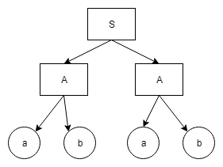
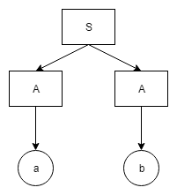
Projectional world
Language: Abstract Syntax Tree (AST)
Program: Model constructed from the AST definition
Also results in a Tree
Example:
Language
Program

Slide 8
Jetbrains MPS
Projectional language workbench
Languages defined as AST models
Programs as models constructed from the AST meta-model
Support model transformations, model checking

Slide 9
Goals
Structure
Create equivalent projectional (AST) models from a given grammar
Minimize manual effort required
Maintain as much of the original structure as possible
If not possible to maintain some structure, offer an alternative
Look-and-feel (Editor)
Increase the usability of the created projectional model
Offer default visual representation
Programs
Create projectional model for a given (already imported) language and a given (valid) string

Slide 10
Motivation
Grammars have been widely used for language definition for a long time
The projectional approach is model-based and has several advantages:
Model transformations
Model checking
Programs by construction
However recreating grammars as projectional models by hand is a lot of work!
Automating this process will make it possible for a language engineer to take advantage of the projectional approach with minimal time investment.

Slide 11
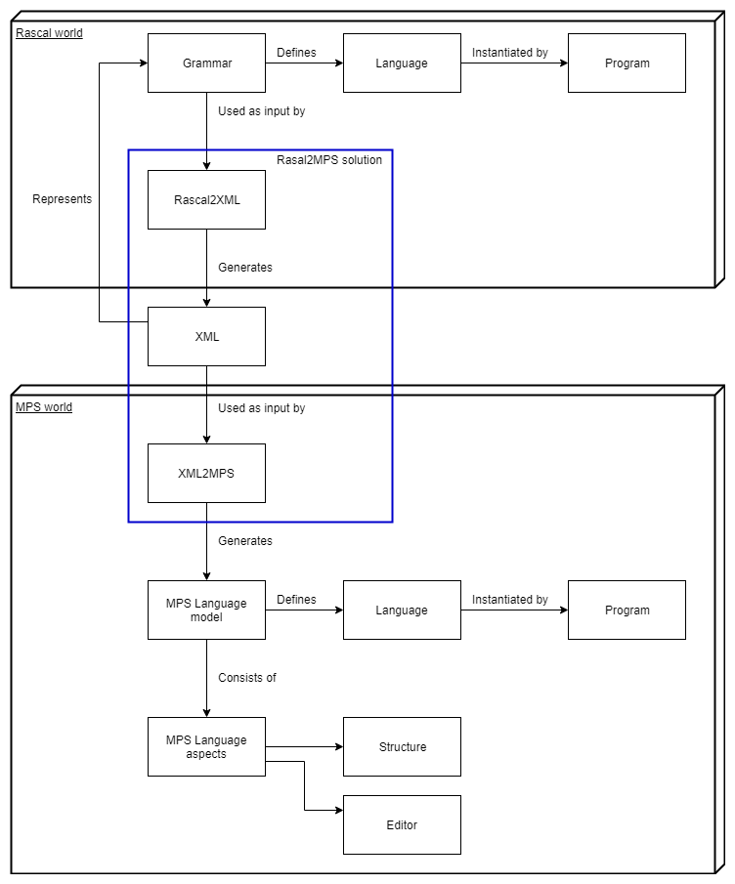
General overview

Slide 12
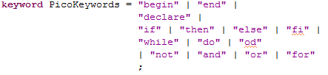
Running example - Pico
Simple Rascal grammar
Contains:
Production rules
Lexicals
Keywords
Layout

Slide 13
Pico – Program rule
Label: prog
Literals/terminals: “begin”, “end”
Non-terminals: Declarations decls, {Statement “;”}* body
*-quantifier: 0..N

Slide 14
Structure
The goal is to create an equivalent projectional AST model for a given grammar
Solution:
Transform the grammar into a tree(-like) structure
Move this structure to the projectional “world”
Create the equivalent projectional AST model based on this structure

Slide 15
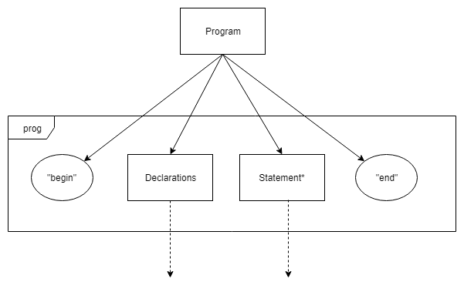
Grammar to tree

Slide 16
Grammar to tree
There already exist ways to generate a parse tree from a grammar and a given valid program
This parse tree contains the information we need
Functionality for this exists in Rascal

Slide 17
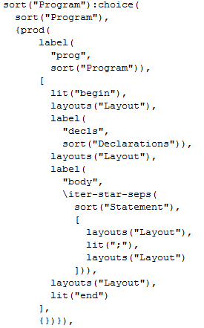
Grammar to tree – Rascal example
In Rascal, we can access this parse tree for any valid grammar
The result is a Rascal Tree type

Slide 18
From one workbench to another
We need to be able to communicate information between Rascal and MPS
Two main options:
Call Rascal directly from within MPS
Rascal is implemented in Java
MPS can include and call external JARs
Gives direct access to Rascal functions and types inside of MPS
Use an intermediary (2-step approach)
Write the tree to some external data storage, i.e. JSON, XML, Binary, Database
Import this stored data into MPS

Slide 19
From one workbench to another
We need to be able to communicate information between Rascal and MPS
Two main options:
Call Rascal directly from within MPS
+ Streamlined solution
- Strongly binds the solution to Rascal
- Technical limitations
Use an intermediary (2-step approach)
+ Decouples source and target workbench
+ Easier to debug
- Requires physical storage and disk operations
- Requires more manual work during the process

Slide 20
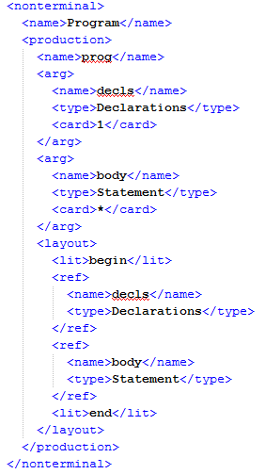
Intermediary format
XML
Supported by Rascal and MPS
File-based
Translation from parse tree to DOM is clear

Slide 21
Tree to projectional AST model
We are now ready to start building the projectional AST model
The steps are as follows:
Read the XML representation of the grammar into a tree structure in MPS
Walk over this tree top-down
For each node, create an equivalent AST model element
Maintain the relations between elements

Slide 22
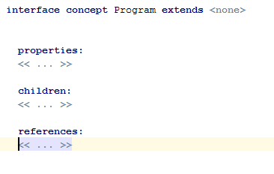
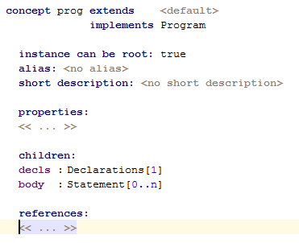
Structure - Example

Slide 23
Editor – Visual representation in MPS
Since a projectional editor is model-based, there is no direct visual representation
Instead, each AST node (concept) has it’s own visual definition called the editor
In this editor you can specify:
Layout (whitespace)
Literals
Each concept is given a default editor upon creation
… however it very basic

Slide 24
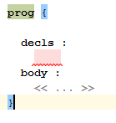
Default editor

Slide 25
Improving the default editor
In order to offer a more usable language, we should add some features:
Maintain literals from the concrete syntax
Keyword highlighting
Indentation
Alternatively, ask for user input to determine visual representation
However the user can already change the editor manually, so this is just adds a layer

Slide 26
Creating the MPS editor
The editor is created as follows:
First create all AST model elements (concepts and interfaces)
Then for each concept:
Read layout information (stored in the tree)
For each layout element:
Determine the position (indentation)
Determine whether it is a keyword – If yes color
Determine if it is a literal or reference to a child node.
Create the correct “editor cell” and add it to the editor

Slide 27
Indentation
When to indent – not a trivial problem
Best guess based on heuristics:
Indent on the following patterns:
t N (t N)* t
t N (t N)+
Where t = terminal and N = Nonterminal
No indent otherwise
Captures common structures well (if, for, when)
Based on the paper “Generation of formatters for context-free languages”
Not a one-size fits all solution – expected to be customized by language engineer

Slide 28
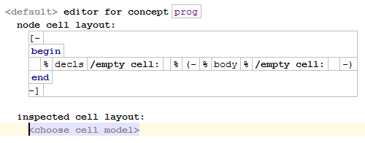
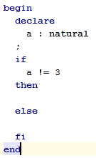
Editor

Slide 29
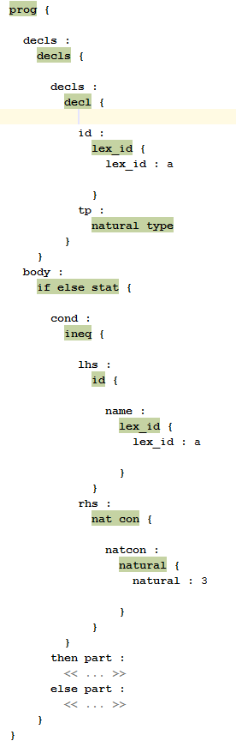
Editor - Comparison

Slide 30
Programs
Now that we have the language structure and editor, we are free to start creating new programs from within MPS
However, programs already created in the textual world (as plain-text files) cannot be used
Recreating them as MPS models by hand costs time and effort
Can we automate this aswell?

Slide 31
Programs – General overview
The general idea is the same as with languages:
Generate parse tree
Export the tree to XML
Import the XML file in MPS
For each node in the parse tree (bottom up):
Create an instance of a language concept and add it to the model
The last step requires the language to be already known in MPS
Currently work in progress

Slide 32
Goals revisited
The following goals we set out:
Create an equivalent projectional AST model for a given grammar
Improve the default editor
Recreate textual programs as projectional models.
The first two goals have been completed, the last is work in progress

Slide 33
Previous work
Ingrid
Master’s project at Charles University, Prague in 2016
MetaBNF
Test project by DSLFoundry

Slide 34
Comparison – Ingrid
MPS plugin for creating MPS AST models from ANTLR grammars
Creates very basic editor with no indentation
Does not allow for the importing of programs
Does include the ability to output MPS program models to plain text

Slide 35
Comparison – MetaBNF
Alternative approach:
Model ANTLR itself as MPS Language
Recreate an ANTLR grammar in MPS using this Language
Apply model-to-model transformation to generate the Language represented by the original grammar
Requires the language engineer to recreate the grammar manually, which is what we want to prevent.

Slide 36
Future work
Bi-directional importing:
Generate grammars and plain-text programs from projectional models
Extend editor framework:
Support for custom “stylesheets”

Slide 37
Conclusion
This project aims to enable the reuse of languages and programs defined in the textual world in the projectional world. To this end we have implemented solutions to three separate sub-goals, which together achieve this goal.

Slide 38
References
Ingrid: https://github.com/premun/ingrid
MetaBNF: https://github.com/DSLFoundry/mps-metabnf
Rascal: https://www.rascal-mpl.org/
Jetbrains MPS: https://www.jetbrains.com/mps/
Indentation heuristics: Van Den Brand, Mark, and Eelco Visser. "Generation of formatters for context-free languages." ACM Transactions on Software Engineering and Methodology (TOSEM) 5.1 (1996): 1-41.

